Slide 1
FRB Update #18
William Huang
(9/28/2020)

Slide 2
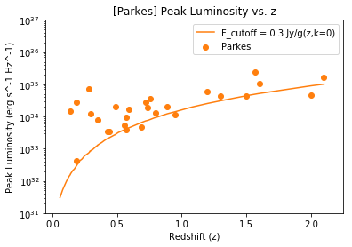
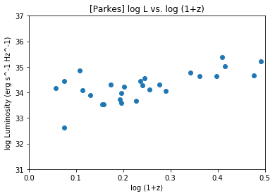
log (L_p) vs. log(1+z) for Parkes
On the right is the log L vs. log (1+z) graph. It is compared with the L_p vs. z graph on the left, with L in log scale and z in linear.

Slide 3
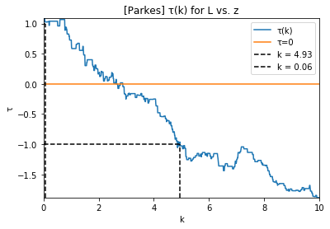
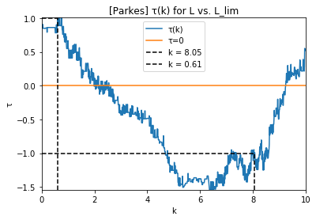
τ(k) for Parkes only
τ(k) is shown in both graphs, where on the left L vs. z was used and on the right L vs. L_lim was used, with L_lim = L_p * (0.3 Jy / F_p). The value of k such that τ(k) was 0 was k=2.60 and k=2.02, respectively.

Slide 4
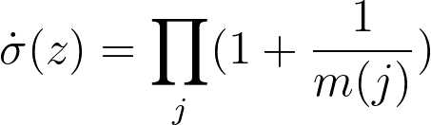
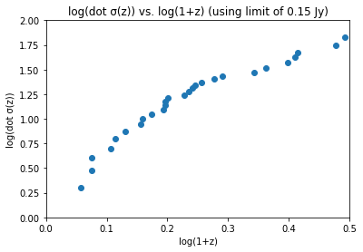
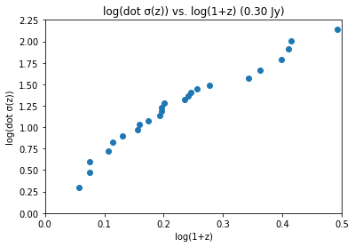
dotsigma
Previously, dot σ(z) was obtained using a 0.15 Jy limit, and the broken power law fits are fitted to the 0.15 Jy limit. The new limit of 0.30 Jy gives the plot on the right; the y-axis scale is [0, 2.25] instead of [0, 2.00].

Slide 5
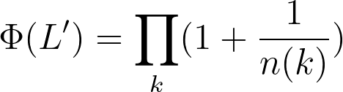
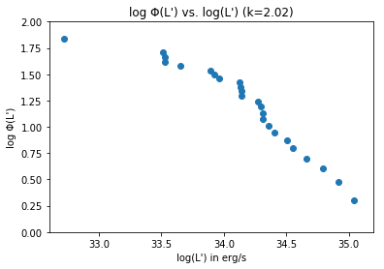
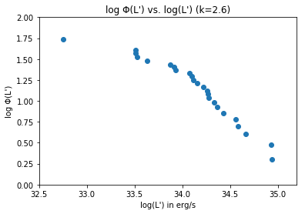
Cumulative Phi
Cumulative Phi is plotted at k=2.6 and k=2.02, the two values given by the two different methods of kendall tau.

